Slide 1

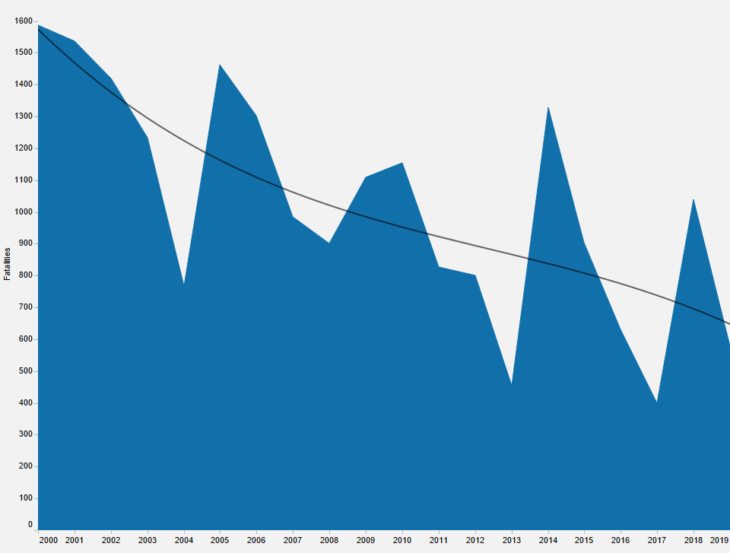

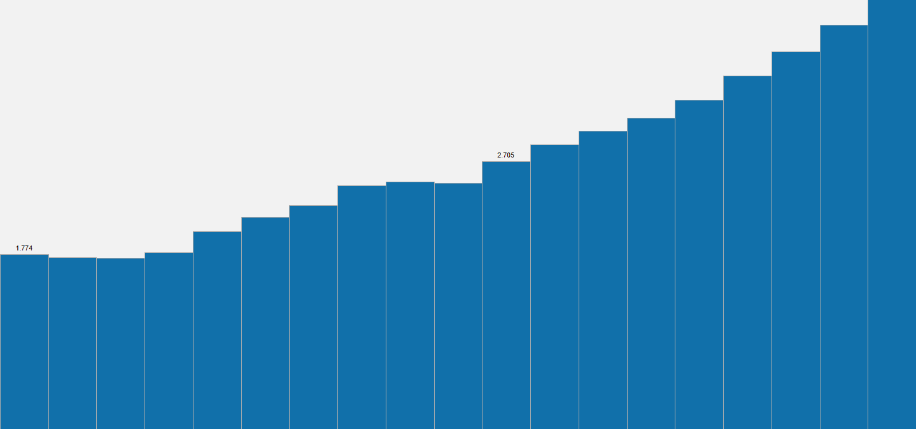


Airline Safety
How Safe Is Flying Today?
Fact #1
2000
Since 2000, there has been a consistent downward trend in global fatalities related to air travel.
2019
Fact #2
Since 2007, U.S. Carriers have had
accidents resulting in fatalities.
2
Fact #3
Annual number of global air travelers has increased 143% from 2000 to 2018.
4.3 Billion
1.7 Billion
2000
2018
Fact #4
For every fatal U.S. Carrier accident since 2009, there have been 131,803 fatal auto accidents in the U.S.
Fact #5
0.0000112%
Percentage of all global flights between 2000 – 2014 involved in a fatal accident.
Fact #6
Annual revenue has increased over the past decade, allowing for continued reinvestment into technology and safety improvements.
Sources
Airline Safety, Aviation Safety Network
Death Rate Per Year, Bureau of Aircraft Accident Archives
Safety Record of U.S. Air Carriers, Airlines for America
Annual Financial Results: U.S. Passenger Airlines, Airlines for America
World Airlines Traffic and Capacity, Airlines for America
Fatality and Injury Reporting System Tool (FIRST), National Highway Traffic Safety Administration (NHTSA)
Additional information can be found at https://dsc640-doug-marcum.blogspot.com/

